Slide 1
Algorithms and Data Structures
Lecture VIII
Simonas Šaltenis
Nykredit Center for Database Research
Aalborg University
simas@cs.auc.dk

Slide 2
This Lecture
Red-Black Trees
  Properties
  Rotations
  Insertion
  Deletion

Slide 3
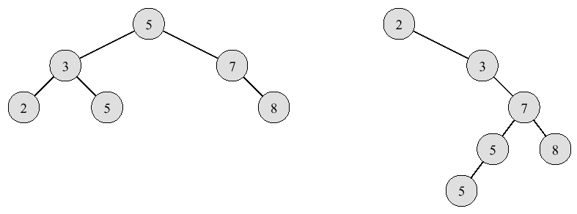
Balanced Binary Search Trees
Problem: worst-case execution time for dynamic set operations is Θ(n)
Solution: balanced search trees guarantee small (logarithmic) height!

Slide 4
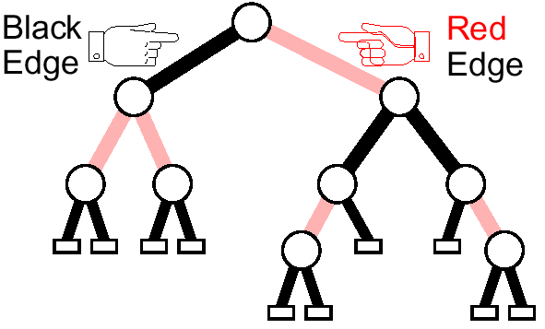
Red/Black Trees
A red-black tree is a binary search tree with the following properties:
  Edges (nodes) are colored red or black
  Incoming edges of leaves are black
  No two consecutive red edges on any root-leaf path
  Same number of black edges on any root-leaf path
  (= black height of the tree)

Slide 5

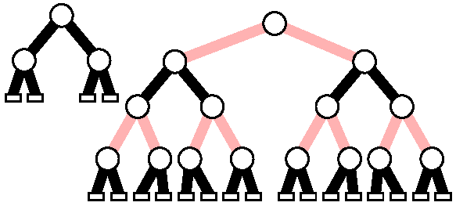
More RB-Tree Properties
Some measures
  n – # of internal nodes
  l – # leaves (= n + 1)
  h – height
  bh – black height
Property 1:

Slide 6
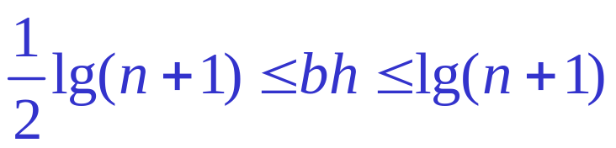

More RB-Tree Properties (2)
Property 2:
Property 3:
Operations in the binary-search tree (search, insert, delete, ...) can be accomplished in O(h) time
Consequently, the RB-tree is a binary search tree, whose height is bound by 2 log(n+1), the operations run in O(log n)

Slide 7
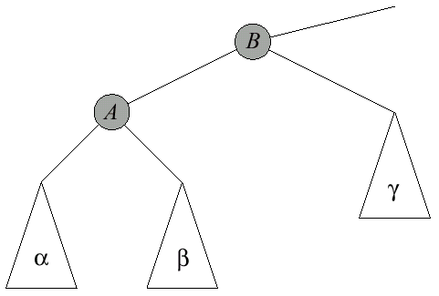
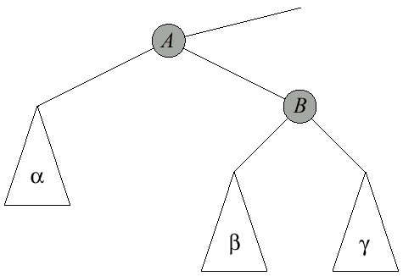
Rotation
right rotation of B
left rotation of A

Slide 8
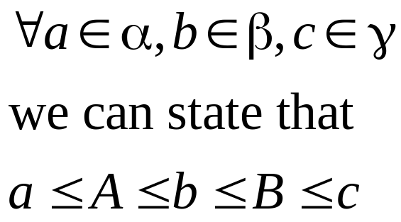
Rotation (2)
The basic operation for maintaining balanced trees
Maintains inorder key ordering
After left rotation (right rotation has the opposite effect)
  Depth(α) decreases by 1
  Depth(β) stays the same
  Depth(γ) increases by 1
Rotation takes O(1) time

Slide 9
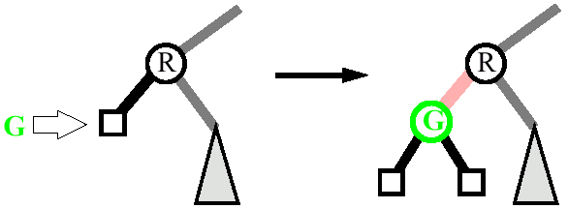
Insertion in the RB-Trees
Perform a standard search to find the leaf
Replace the leaf with an internal node with the new key. The new node has two children (leaves) with black incoming edges
Color the incoming edge of the new node red
If the parent has an incoming red edge, we have two consecutive red edges! We must re-organize a tree to remove that violation.

Slide 10
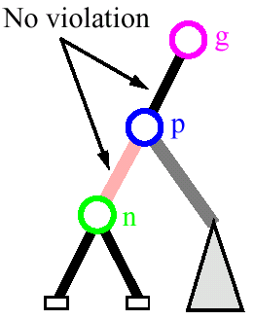
Insertion, Plain and Simple
Let
  n … the new node
  p … its parent
  g … its grandparent
Case 0: Incoming edge of p is black
Insertion algorithm stops here.
No further manipulation of the tree necessary!

Slide 11
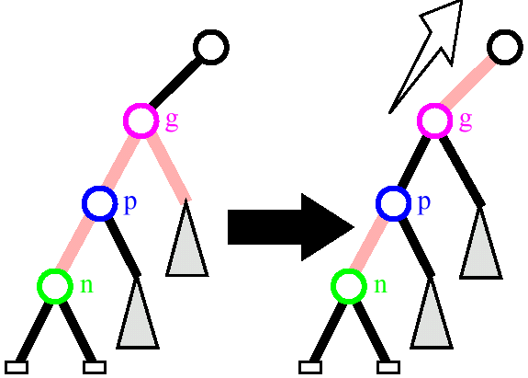
Insertion: Case 1
Case 1: Incoming edge of p is red and its sibling (uncle of n) has a red incoming edge
  a tree rooted at g is balanced enough

Slide 12
Insertion: Case 1 (2)
We call this a promotion
Note how the black depth remains unchanged for all of the descendants of g
This process will continue upward beyond g if necessary; rename g as n and repeat

Slide 13
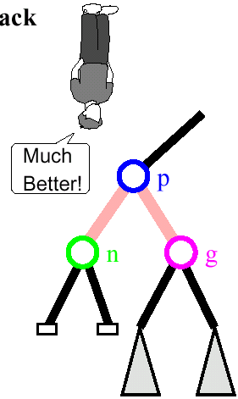
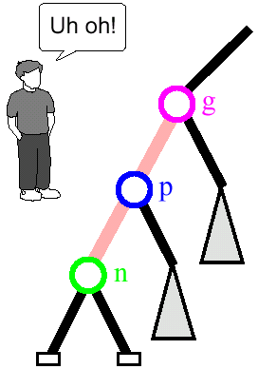
Insertion: Case 3
Case 3: Incoming edge of p is red, its sibling has black incoming edge and n is left child of p
We do a “right rotation”
No further work on tree is necessary
Inorder remains unchanged
Tree becomes more balanced
No two consecutive red edges!

Slide 14
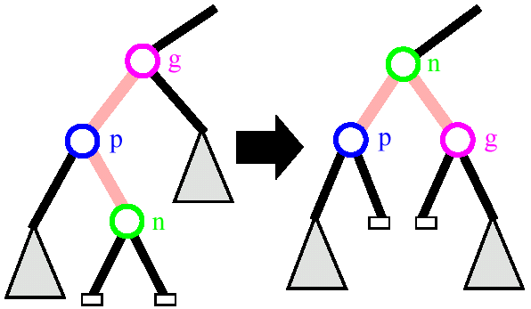
Insertion: Cases 2
Case 2: Incoming edge of p is red, its sibling has black incoming edge and n is a right child of p
  We must perform a “double rotation” – left rotation around p (we end in case 3) followed by right rotation around g

Slide 15
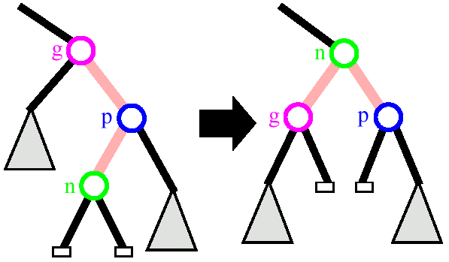
Insertion: Mirror cases
All three cases are handled analogously if p is a right child
  For example, case 2 and 3 – right-left double rotation

Slide 16
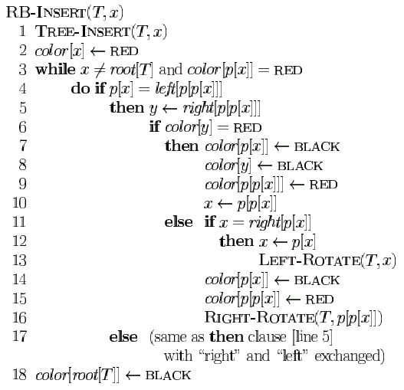
Insertion: Pseudo Code
Case 1
Case 2
Case 3

Slide 17
Insertion Summary
If two red edges are present, we do either
  a restructuring (with a simple or double rotation) and stop (cases 2 and 3), or
  a promotion and continue (case 1)
A restructuring takes constant time and is performed at most once. It reorganizes an off-balanced section of the tree
Promotions may continue up the tree and are executed O(log n) times (height of the tree)
The running time of an insertion is O(log n)

Slide 18
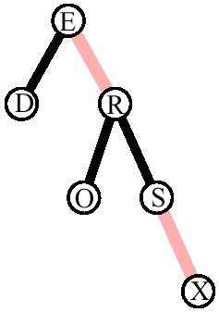
An Insertion Example
Inserting "REDSOX" into an empty tree
Now, let us insert "CUBS"

Slide 19
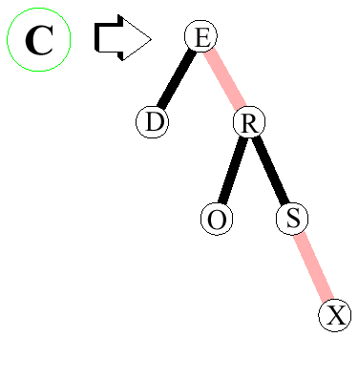
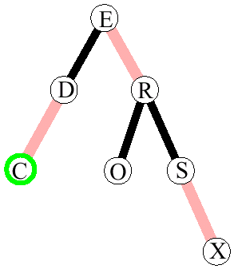

Example C

Slide 20
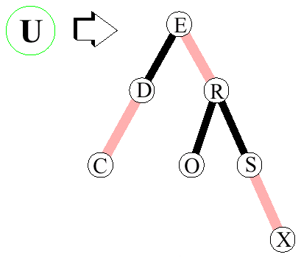
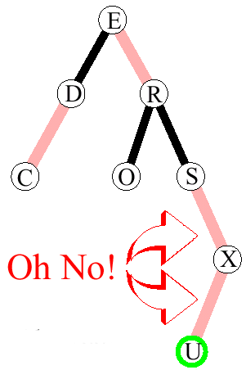
Example U

Slide 21
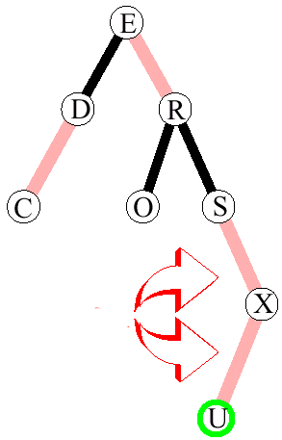
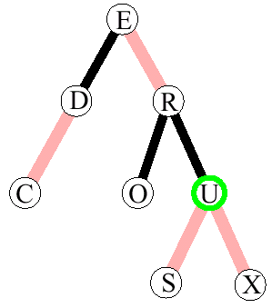
Example U (2)
Double Rotation

Slide 22

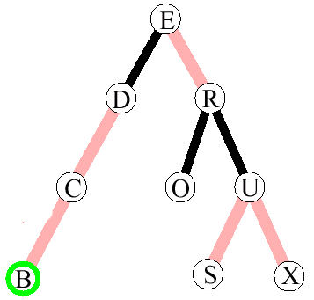
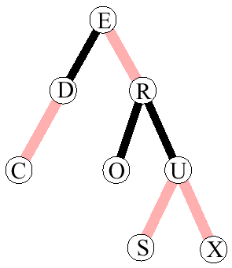

Example B
What now?

Slide 23
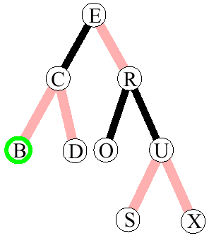
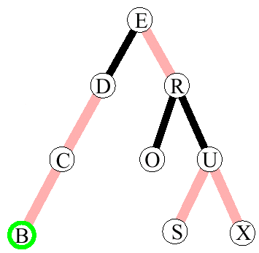
Example B (2)
Right Rotation on D

Slide 24
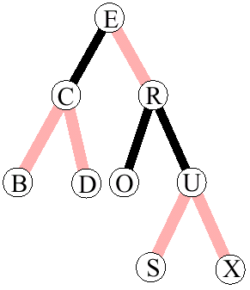
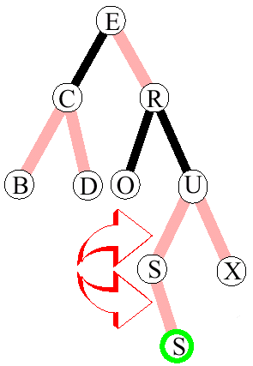

Example S
two red edges and red uncle X- promotion
could have placed it on either side

Slide 25
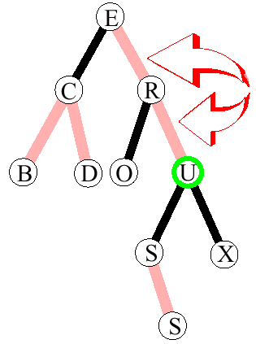
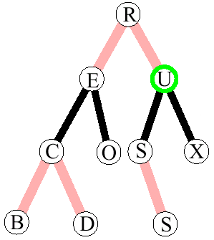
Example S (2)
again two red edges - rotation

Slide 26
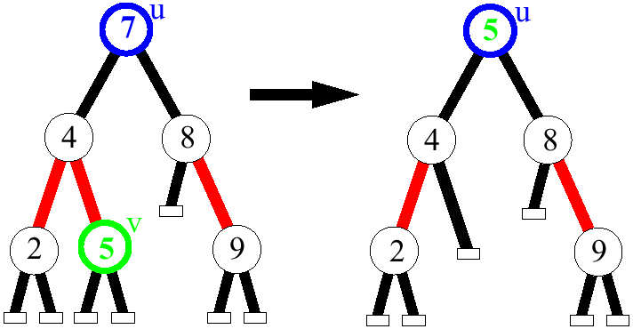
Deletion
As with binary search trees, we can always delete a node that has at least one external child
If the key to be deleted is stored at a node that has no external children, we move there the key of its inorder predecessor (or successor), and delete that node instead
  Example: to delete key 7, we move key 5 to node u, and delete node v

Slide 27
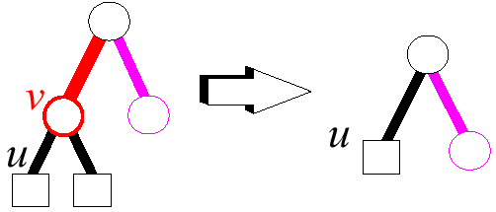
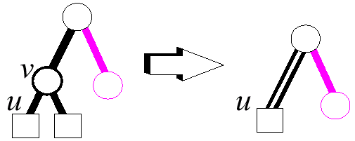
Deletion Algorithm
1. Remove v
2. If v had a red incoming edge, we are done. Else, color u (v’s child) double black.

Slide 28
Deletion Algorithm (2)
How to eliminate double black edges?
  The intuitive idea is to perform a "color compensation"
    Find a red edge nearby, and change the pair (red, double black) into (black, black)
  As for insertion, we have two cases:
    restructuring, and
    recoloring
  Restructuring resolves the problem locally, while recoloring may propagate it two levels up
  Slightly more complicated than insertion

Slide 29
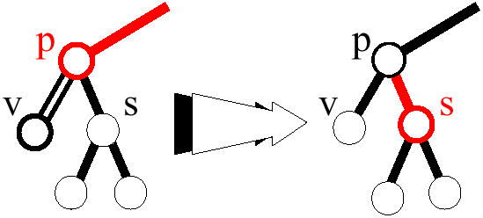
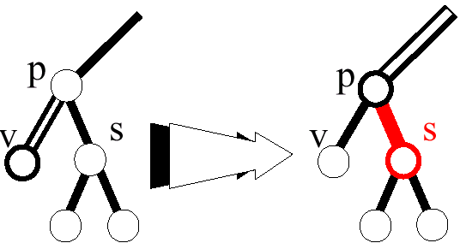
Deletion Case 2
If sibling and its children are black, perform a recoloring
If parent becomes double black, continue upward

Slide 30
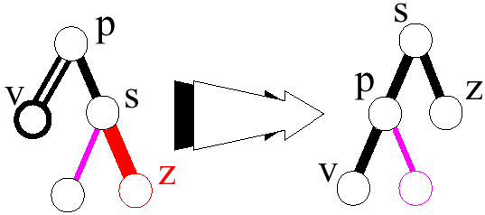
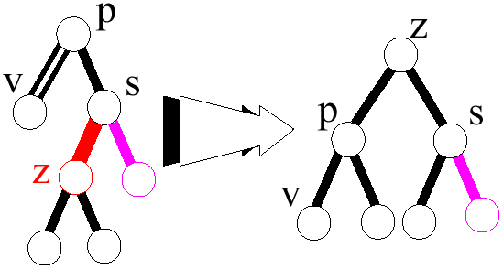
Deletion: Cases 3 and 4
If sibling is black and one of its children is red, perform a restructuring

Slide 31
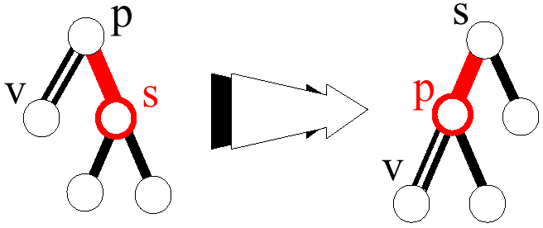
Deletion Case 1
If sibling is red, perform a rotation to get into one of cases 2, 3, and 4
If the next case is 2 (recoloring), there is no propagation upward (parent is now red)

Slide 32
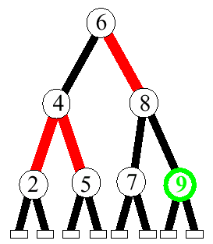
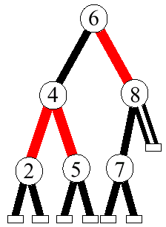
A Deletion Example
Delete 9

Slide 33
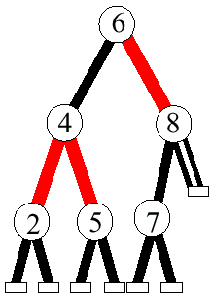
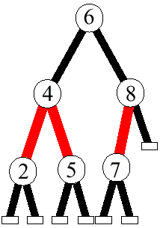
A Deletion Example (2)
Case 2 (sibling is black with black children) – recoloring

Slide 34
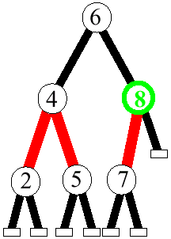
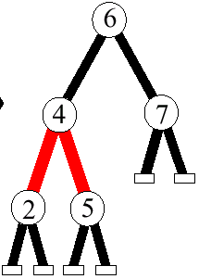
A Deletion Example (3)
Delete 8: no double black

Slide 35
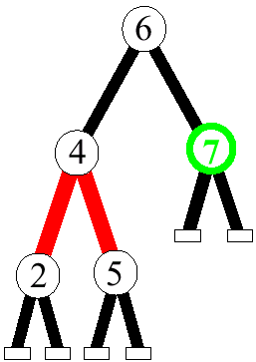
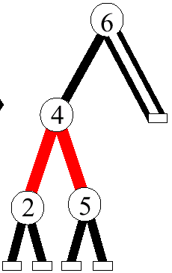
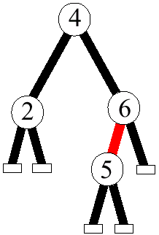
A Deletion Example (4)
Delete 7: restructuring

Slide 36
How long does it take?
Deletion in a RB-tree takes O(log n)
  Maximum three rotations and O(log n) recolorings

Slide 37


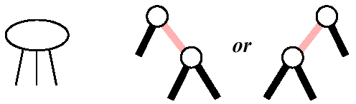
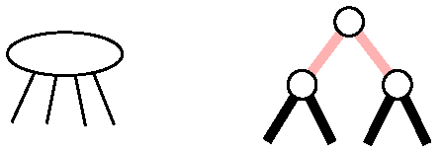
Other balanced trees
Red-Black trees are related to 2-3-4 trees (non-binary trees)
AVL-trees have simpler algorithms, but may perform a lot of rotations

Slide 38
Next Week
External storage search trees:
  B-Trees

